Slide 1
CSET301 – AI-ML
Lecture 2 : Types of Machine Learning

Slide 2
Types of Machine Learning
Machine learning (ML) is a branch of computer science that enables computers to learn and make decisions or predictions based on data without being explicitly programmed.
It achieves this by using algorithms to identify patterns, extract insights, and make decisions with minimal human intervention.
Machine learning is broadly categorized into three types: Supervised Learning, Unsupervised and Reinforcement Learning

Slide 3
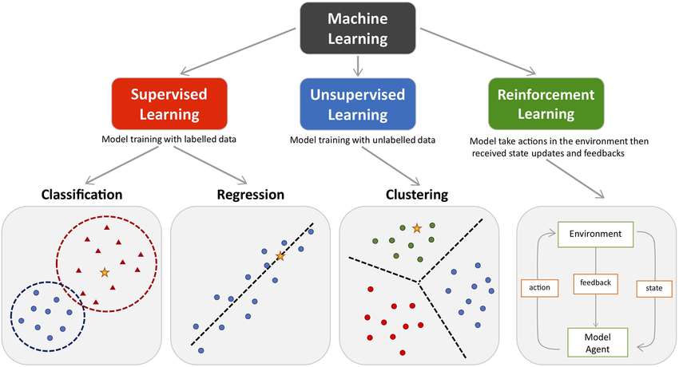

Types of Machine Learning

Slide 4

Supervised Learning
Supervised learning involves training a ML model on a labeled dataset. This dataset consists of input data paired with corresponding correct outputs, often referred to as labels. The algorithm learns to map the input data to the desired output and can make accurate predictions when presented with new, unseen data.
Key Characteristics of Supervised Learning
Uses labeled data for training.
Aims to predict outcomes for new inputs.
Suitable for tasks such as classification, regression, and object detection.

Slide 5
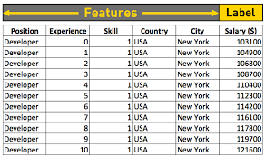

Supervised Learning
Example of label dataset

Slide 6
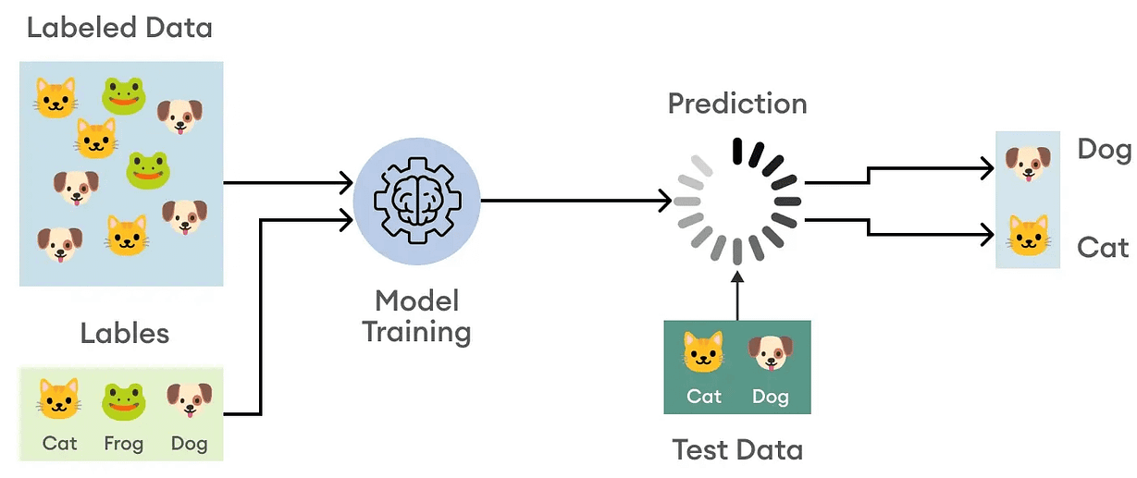

Supervised Learning: Examples
Image Recognition
Suppose we want to train a model to recognize animals.
Labeled Dataset: A dataset of animal images, where each image is tagged as "elephant," "camel," or "cow.“
Process: The model learns to identify patterns, such as the shape, size, and texture of each animal.
Prediction: When shown a new image, the model predicts the animal's label based on the patterns it has learned.

Slide 7
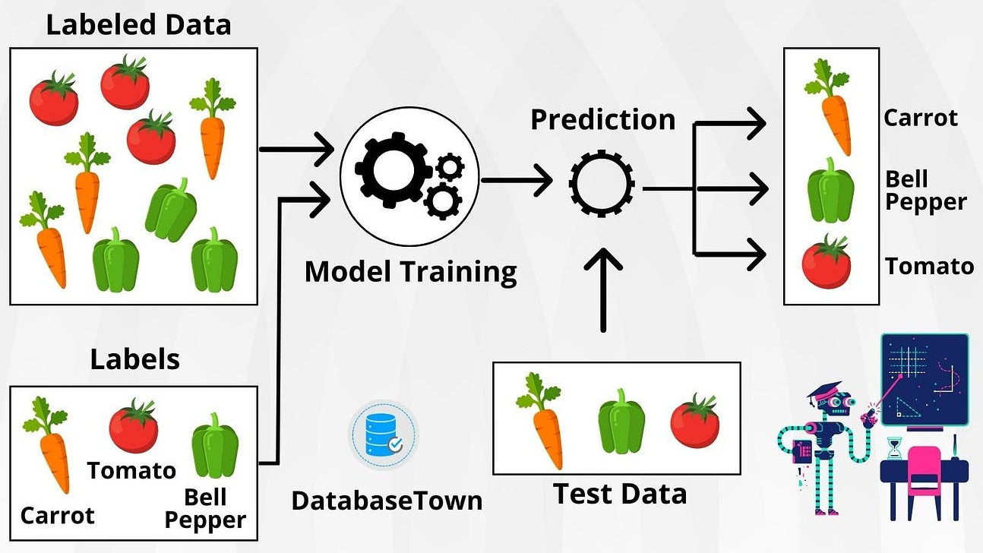

Supervised Learning: Examples
Veggie Classification
Training Data:
If it is round and red -> tomato
If it is long and orange/red -> carrot
Testing: When presented with a new veggie, such as a carrot, the model analyzes its shape and color to correctly identify it.

Slide 8

Unsupervised Learning
Unsupervised learning works on unlabeled data. The goal is to identify patterns, relationships, or structures within the data without predefined labels or guidance.
Key Characteristics of Unsupervised Learning
Works on unlabeled datasets.
Identify hidden structures in the data.
Suitable for tasks such as clustering, dimensionality reduction, and anomaly detection

Slide 9
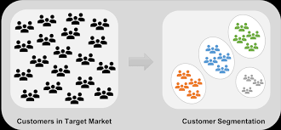

Unsupervised Learning: Examples
Customer Segmentation
Businesses use unsupervised learning to group customers based on their purchasing behavior.
Data: Purchase history, demographics, and preferences.
Outcome: Customers are segmented into groups like "budget buyers," "premium customers," etc.

Slide 10
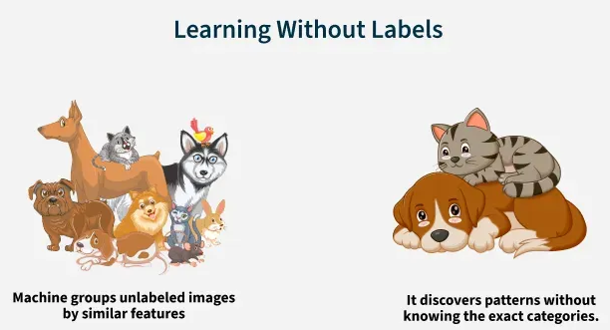

Unsupervised Learning: Examples
Animal Grouping
A ML model can be trained on images of animals (without labels) to group similar species based on shared characteristics.
Outcome: The model clusters the data into groups (e.g., one for dogs, another for horse) based on similarities.

Slide 11
Reinforcement Learning (RL)
It is a type of machine learning where an agent learns to make decisions by interacting with an environment.
The agent learns to perform actions that maximize a cumulative reward through a process of trial and error.
Unlike supervised learning, RL does not rely on labeled data but instead uses feedback in the form of rewards or penalties.

Slide 12
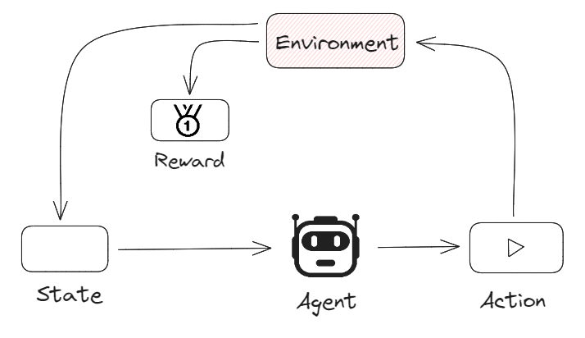

Reinforcement Learning (RL)
Core Components of RL:
Agent: The decision-maker in the system. Ex: A self-driving car, a robot, or an AI player in a game.
Environment: The world in which the agent operates. Ex: Roads for a self-driving car or a chessboard for a chess-playing AI.
State (S): Represents the current situation of the environment. Ex: The position of a car on the road or the arrangement of pieces on a chessboard.
Action (A): The decision or move the agent can make at any state. Ex: Speed up, slow down, turn left for a car; move a pawn or queen in chess.

Slide 13

Reinforcement Learning (RL)
Key Concepts of RL:
Reward (R): Feedback the agent receives after taking an action. Ex: Positive reward for avoiding a collision; negative reward for hitting an obstacle.
Policy (π): The strategy or mapping the agent uses to decide actions based on the current state. Ex: If traffic is heavy, slow down.
Value Function (V): Predicts the expected long-term reward for a given state. Ex: Estimating the benefits of a particular position on the chessboard.
Q-value or Action-value (Q(S,a)): Predicts the expected reward for taking a specific action in a given state.

Slide 14

Reinforcement Learning (RL)
Key Concepts of RL:
Exploration vs. Exploitation
  Exploration: Agent try new actions to learn about the environment and discover potential new strategies.
  Exploitation: Agent choose actions that maximize rewards based on current knowledge
Markov Decision Process (MDP): A mathematical framework for modeling decision-making in RL. Includes states, actions, rewards, and probabilities of transitioning from one state to another.
Reward Signal: Feedback the agent receives from the environment after taking an action
Discount Factor (γ): Determines the importance of future rewards versus immediate rewards. A value closer to 1 means future rewards are more significant.

Slide 15


Reinforcement Learning (RL): Examples
Problem: Train a robot to move to a specific location in a room.
State: The robot's position in the room.
Action: Move forward, backward, left, or right.
Reward:
  +10 for reaching the destination.
  -1 for each step taken.
  -5 for hitting a wall.
Process:
The robot starts randomly moving around, hitting walls, and learning over time to avoid them. Gradually, it finds the shortest path to the target location to maximize its reward.

Slide 16

Types of ML: Summary
 | Supervised Learning | Unsupervised Learning | Reinforcement Learning
Data Requirement | Requires labeled data (input-output pairs). | Uses unlabeled data. | No labeled data; interacts with an environment.
Goal | Learn a mapping from inputs to outputs. | Find hidden patterns or structures. | Maximize cumulative reward through trial and error.
Feedback | Explicit feedback (correct labels provided). | No feedback; patterns are discovered independently. | Feedback in the form of rewards or penalties.
Common Applications | Classification, regression. | Clustering, dimensionality reduction. | Robotics, gaming, autonomous systems.
Key Challenge | Requires high-quality labeled data. | Interpreting discovered patterns. | Balancing exploration vs. exploitation.
Examples | Predicting house prices, image classification. | Customer segmentation, market basket analysis. | Teaching robots, AI in games, self-driving cars

Slide 17

Learning Algorithm
A learning algorithm is a core component of machine learning that allows a model to learn patterns and make predictions from data. These algorithms fall under various categories based on the type of learning involved and the problem they solve.
1. Supervised Learning
Definition: The algorithm is trained on labeled data (input-output pairs).
Objective: Learn a mapping from inputs (features) to outputs (labels or targets).
Examples:
  Linear Regression: Predict house prices based on features like size, location, etc.
  Logistic Regression: Classify emails as spam or not spam.
  Decision Trees: Predict if a student will pass based on study hours.

Slide 18

Learning Algorithm
2. Unsupervised Learning
Definition: The algorithm is trained on data without explicit labels.
Objective: Discover patterns or structure in the data.
Examples:
  Clustering (e.g., K-Means): Group customers based on purchasing behavior.
  Dimensionality Reduction (e.g., PCA): Compress data while retaining meaningful information for visualization or analysis.

Slide 19

Learning Algorithm
3. Semi-Supervised Learning
Definition: Uses a mix of labeled and unlabeled data for training.
Objective: Leverage large amounts of unlabeled data with a small amount of labeled data to improve learning.
Example: Classify medical images where only a few are labeled (e.g., identifying tumors).

Slide 20

Learning Algorithm
4. Reinforcement Learning
Definition: The algorithm learns by interacting with an environment and receiving feedback in the form of rewards or penalties.
Objective: Maximize cumulative rewards over time.
Examples
  Game Playing (e.g., AlphaGo): Learn strategies for board games like Go or Chess.
  Robotics: Teach robots to walk or navigate obstacles.

Slide 21

Learning Algorithm
Popular RL Algorithms
Q-Learning:- A model-free algorithm that learns the quality of actions. Uses the Bellman Equation to update the Q-values.
  Example: Training a robot to navigate a maze by maximizing rewards for reaching the exit.
Deep Q-Learning (DQN):- Combines Q-Learning with deep neural networks for handling large state spaces.
  Example: Playing Atari games using raw pixel inputs.
Policy Gradient Methods:- Directly optimize the policy to select the best actions.
  Example: Training robots to walk by adjusting their movement policies.
Actor-Critic Methods:- Combines policy-based (actor) and value-based (critic) approaches for better efficiency.
  Example: Simulating complex tasks like assembling parts in manufacturing.

Slide 22

Learning Algorithm
Key Components of a Learning Algorithm
Objective Function:
  Defines what the algorithm is trying to optimize (e.g., minimizing error or maximizing accuracy).
Optimization Technique:
  Methods like Gradient Descent help find the best parameters for the model.
Evaluation Metrics:
  Measure the model's performance (e.g., accuracy, RMSE, F1 score).

Slide 23

Popular Learning Algorithm
Linear Models: Used for simple, interpretable relationships.
  Linear Regression, Logistic Regression.
Tree-Based Models: Useful for non-linear relationships and feature importance.
  Decision Trees, Random Forests, Gradient Boosting (e.g., XGBoost).
Support Vector Machines (SVMs): Effective for classification tasks with a clear margin between classes.
Neural Networks: Used for complex tasks like image recognition and natural language processing.
Clustering Algorithms: Group data into clusters based on similarity.
  K-Means, DBSCAN.
Dimensionality Reduction Algorithms: Reduce data complexity for visualization or feature engineering.
  PCA, t-SNE.

Slide 24
Thank You

